Slide 1

J.a.r.v.i.s Voice assistant
J.a.r.v.i.s AI Assistant
Presented by- Mehedi Hasan (18201042)
Presented by- Mehedi Hasan (18201042)
Kaniz Fatima (18201030)

Slide 2



Contents
JARVIS AI Assistant
Motivation
Importance
Related Existing Platforms
Limitations
Our Proposed Solution
Development Tool
Project Planning

Slide 3
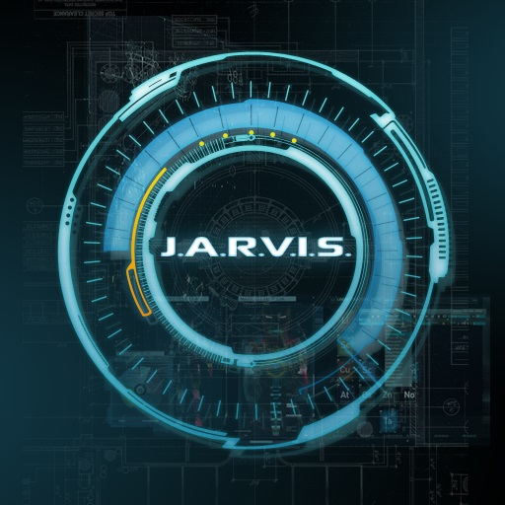
JARVIS AI Assistant
JARVIS AI Assistant is a voice assistant which can do many basic things such as taking simple commands, greeting us, Play songs and many more fun things which will be included in this project later on by using speech recognition.
Objective: The main objective of this project is to build a voice assistant which can be modified and used according to any user specially in platforms like Linux where there’s no built in assistant.

Slide 4

Motivation
It’ll be a simple personal assistant for user
Users can execute tasks by only using their voice in an easy manner
It’ll give users a small taste of using assistants like Siri or Google Assistant

Slide 5

Importance
Easy to implement
Consume less time and space
Can be used as a reminder for important tasks
Could come handy as a music playing assistant

Slide 6



Related existing platforms
Amazon Alexa
Siri
Cortana

Slide 7

limitation
Requested materials are limited, might end up giving an error result
Might not recognize users’ voice properly
Might crash if given too many commands at the same time

Slide 8
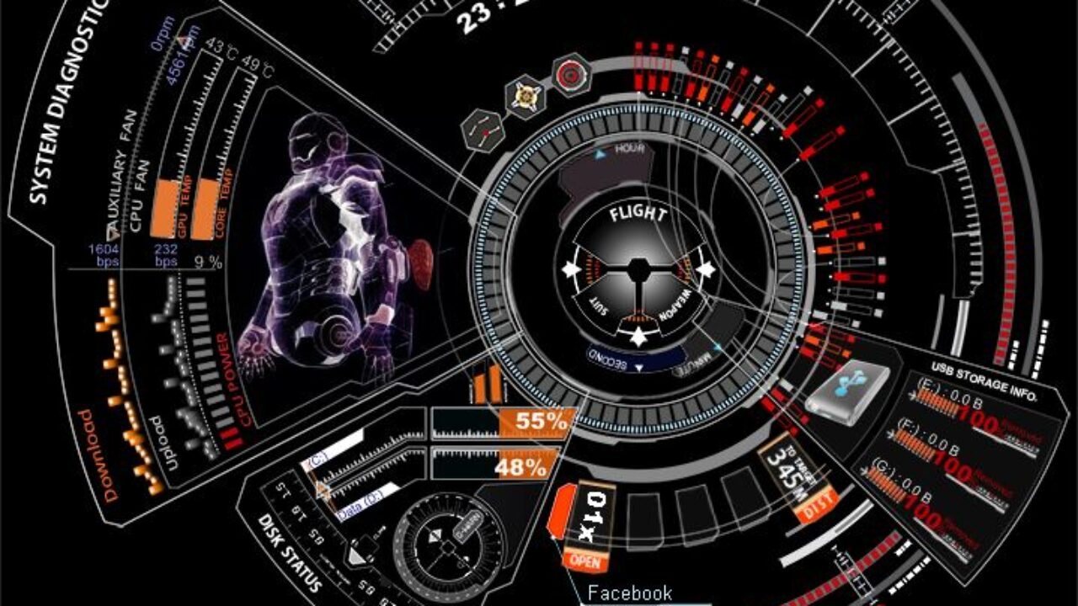
proposed solution
Users can query from website which lightly solves the problem of lack of data
It fulfils the lack of a voice Assistant in Linux or other platforms without a Voice Assistant
It will accept inputs via texts as well for assuring accuracy in result
Overall it’s a pretty safe system to use

Slide 9


Development tool
Language: Python
IDE: Pycharm

Slide 10
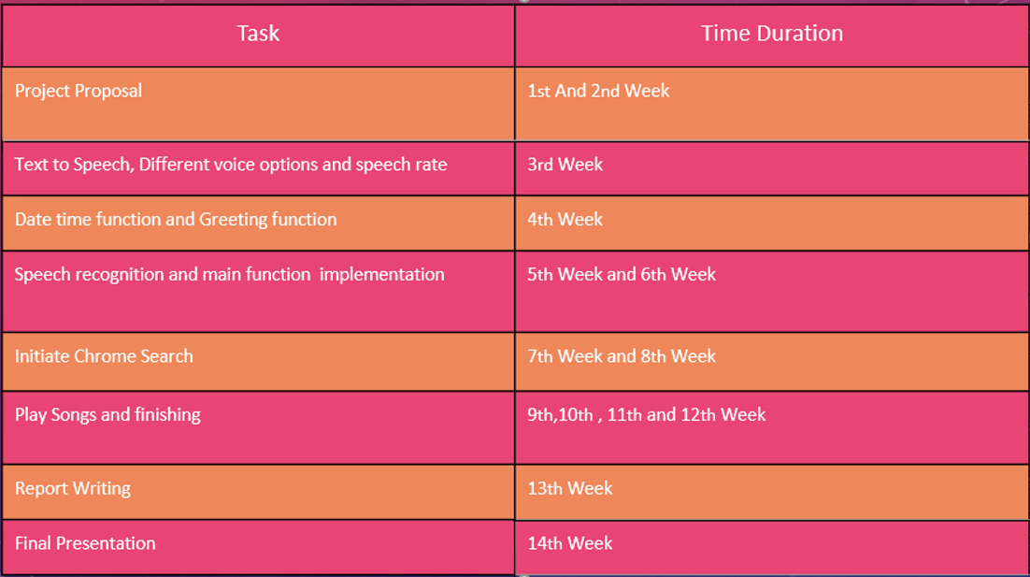
Project Planning

Slide 11
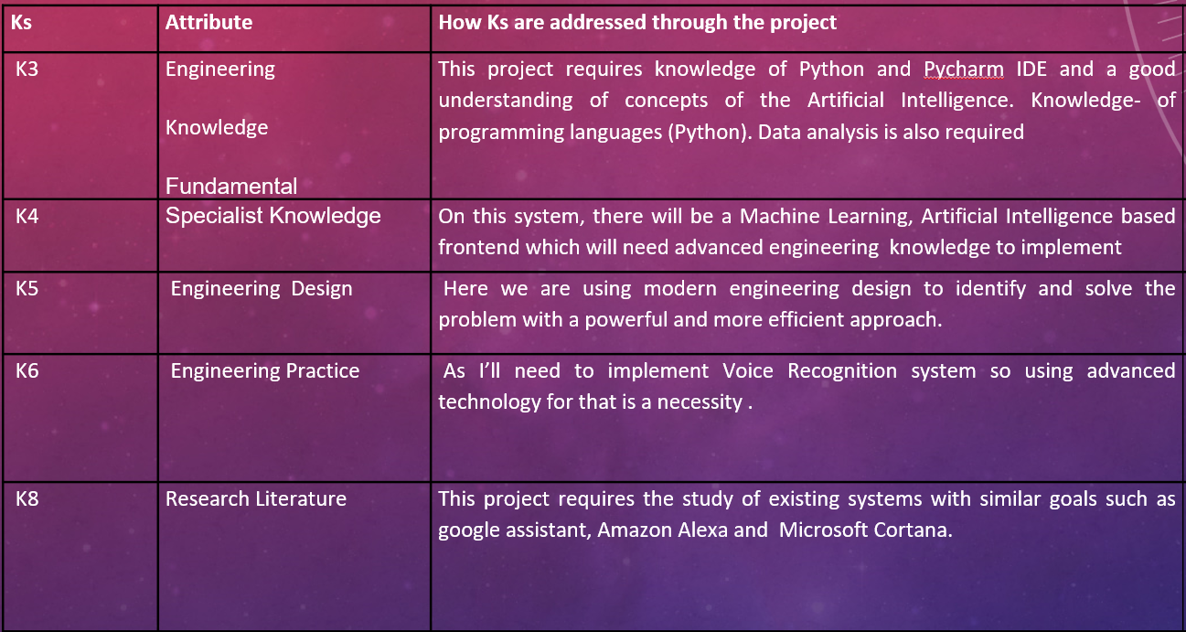
How K’s are addressed through the project

Slide 12
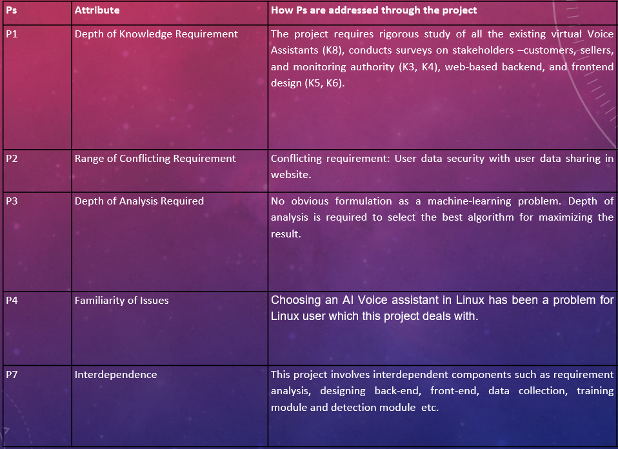
How p’s are addressed through this project

Slide 13

Thank You!

